Slide 1




Graph Traversals
Visit vertices of a graph $G$ to determine some property:
Is $G$ connected?
Is there a path from vertex $a$ to vertex $b$?
Does $G$ have a cycle?
Will removal of a single edge disconnect $G$?
If $G$ is directed, what are the strongly connected components?
If $G$ is the WWW, follow links to locate information.
Most graph algorithms need to examine or process each vertex
and each edge.

Slide 2
Breadth-First Search
Find the shortest path from a source node s to all other nodes.
Outputs
the distance of each vertex from s.
a tree of shortest paths called the breadth-first tree.
Idea: Find nodes at distance 0, then at distance 1, then at
distance 2, …

Slide 3



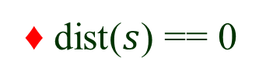
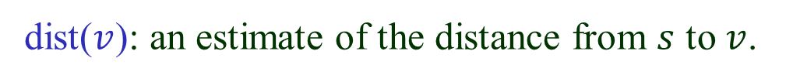
Queue & Distance
BFS uses a queue $Q$ to store nodes.
dist($v$): an estimate of the distance from $s$ to $v$.
Initialization:
♦ $Q$==$\{ s \}$
♦ dist($s$) == 0
♦ dist($v$) == $∞$for$every node other than$s

Slide 4




Overview of the Algorithm
♦ Dequeue a node $u$.
♦ For each neighbor $v$ of $u$ that is being discovered the
first time,
♠ dist($v$) = dist($u$) + 1.
♠ enqueue $v$.

Slide 5

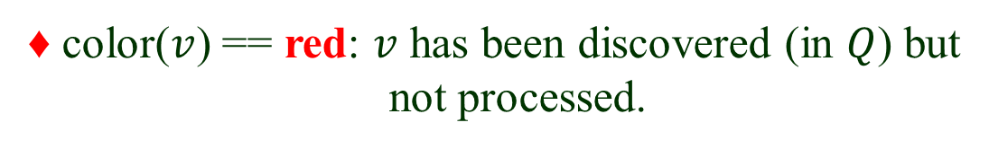
Color Map
Keeps track of the status of nodes.
♦ color($v$) == green: $v$ is undiscovered and unprocessed
♦ color($v$) == red: $v$ has been discovered (in $Q$) but
not processed.
♦ color($v$) == black: $v$ has been discovered and processed
(no longer in $Q$).

Slide 6

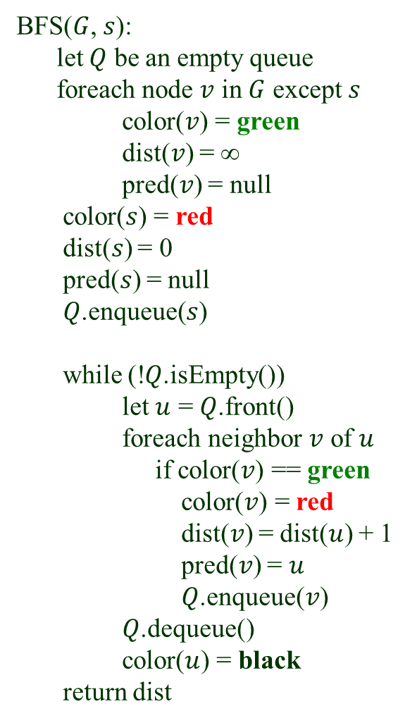
The BFS Algorithm
BFS($G$, $s$):
let $Q$ be an empty queue
foreach node $v$ in $G$ except $s$
color($v$) = green
dist($v$) = ∞
pred($v$) = null
color($s$) = red
dist($s$) = 0
pred($s$) = null
$Q$.enqueue($s$)
while (!$Q$.isEmpty())
let $u$ = $Q$.front()
foreach neighbor $v$ of $u$
if color($v$) == green
color($v$) = red
dist($v$) = dist($u$) + 1
pred($v$) = $u$
$Q$.enqueue($v$)
$Q$.dequeue()
color($u$) = black
return dist
predecessor of $v$ on the path from $s$

Slide 7









A BFS Example
$$b$$
$$s$$
$$e$$
$$c$$
$$g$$
$$a$$
$$f$$
$$d$$
$$Q =↑ s $$

Slide 8




$$b$$
$$s$$
$$e$$
$$c$$
$$g$$
$$a$$
$$f$$
$$d$$
$$Q =\text{⟨} a, c $$
frontier of exploration
Visualized as many simultaneous explorations starting from s and
spreading out independently.

Slide 9






$$b$$
$$s$$
$$e$$
$$c$$
$$g$$
$$a$$
$$f$$
$$d$$
Dashed edges were explored but had
resulted in the discovery of no new
vertices.
$$Q =\text{⟨} c, d⟩$$
⟨ d, e, f ⟩
⟨ e, f ⟩

Slide 10



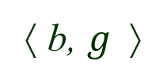

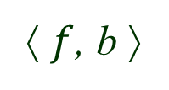

$$b$$
$$s$$
$$e$$
$$c$$
$$g$$
$$a$$
$$f$$
$$d$$
⟨ e, f ⟩
⟨ $f$, b ⟩
⟨ b, $g$⟩

Slide 11



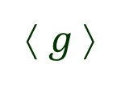



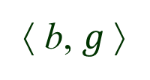


The Finish
$$b$$
$$s$$
$$e$$
$$c$$
$$g$$
$$a$$
$$f$$
$$d$$
Evolution of $Q$(with some intermediate statuses omitted)
⟨ s ⟩
⟨ a, c⟩
⟨ c, d ⟩
⟨ d, e, f ⟩
⟨ e, f ⟩
⟨ f, b⟩
⟨ b, $g$⟩
⟨ $g$⟩
∅

Slide 12



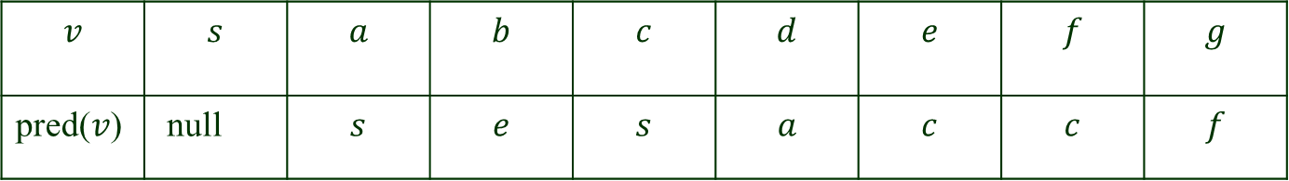





Predecessor Table
$$b$$
$$s$$
$$e$$
$$c$$
$$g$$
$$a$$
$$f$$
$$d$$
$$v$$ | $$s$$ | $$a$$ | $$b$$ | $$c$$ | $$d$$ | $$e$$ | $$f$$ | $$g$$
pred($v$) | null | $$s$$ | $$e$$ | $$s$$ | $$a$$ | $$c$$ | $$c$$ | $$f$$

Slide 13









Breadth-First Tree
Constructed from the predecessor table.
dist($b$): shortest distance from $s$ to $b$
3
0
$$b$$
2
$$s$$
$$e$$
1
3
$$c$$
$$g$$
2
1
$$a$$
2
$$f$$
$$d$$
# visited vertices = 1 + # tree edges
≤ 1 + # explored edges.

Slide 14

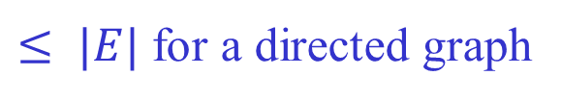






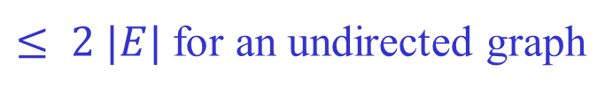

Running Time
$O(|V|+|E|)$if $G$ is represented using adjacency lists.
Every vertex is inserted at most once into $Q$.
# inserted vertices ≤ 1 + # scanned edges
first vertex
# edge scans
$$u$$
$$e$$
$≤ |E|$ for a directed graph
$$v$$
$≤ 2 |E|$for an undirected graph
$$e$$
$$v$$
$$u$$
$O{(|V|}^{2})$if represented as an adjacency matrix.

